Slide 1
National Innovation Centre for Data
Steve Caughey, Director
NICD provides organisations with the skills they need to obtain insight from their data by upskilling their own people on their own platforms using their own data.

Slide 2
Newcastle Data
#1 in Computing for Research Impact [REF 2014]
Engagement
Impact on Industry and Public Sector
Cloud Innovation Centre (£2M)
Teaching Excellence Gold Award [TEF 2017]
World leading in Scalable Data Science [REF 2014]
Innovation
Cycle
EPSRC Centre for Doctoral Training in Cloud Computing for Big Data
Creating the next generation of leaders in Data Science (£5M)
Full Member of the Turing Institute
£100M Research Income in past 10 yrs for Data Science & its Application.
Teaching
Specialist Skills
and Knowledge
Research
in Data Science
and its Application

Slide 3
NICD Programmes
ROI, IP
Skills
Data
Insight
Data
Connections
Data
Skills
£50M Catalyst Building
Ecosystem
Dedicated
Team

Slide 5
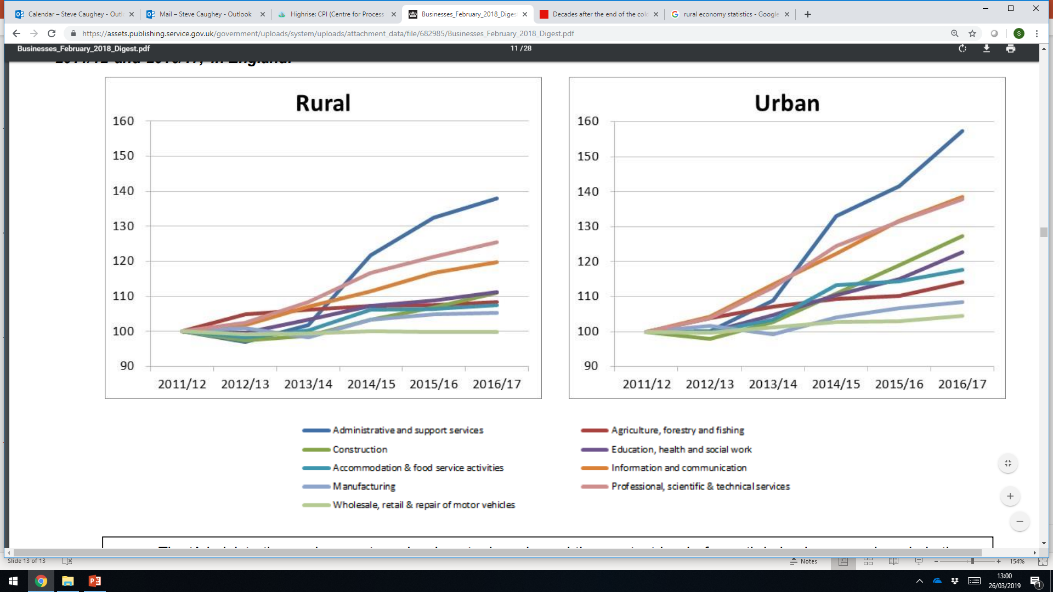
Growth in Rural/Urban economies
Notes:
22% of rural workforce work from home, compared to 12% in urban

Slide 6
NICD Programmes for the rural economy
ROI, IP
Skills
Data
Insight
Data
Connections
Data
Skills
£50M Catalyst Building
Ecosystem
Dedicated
Team

